Slide 1
Helping Your Friends
Grow Toward Jesus
The 5 Thresholds of Faith

Slide 2
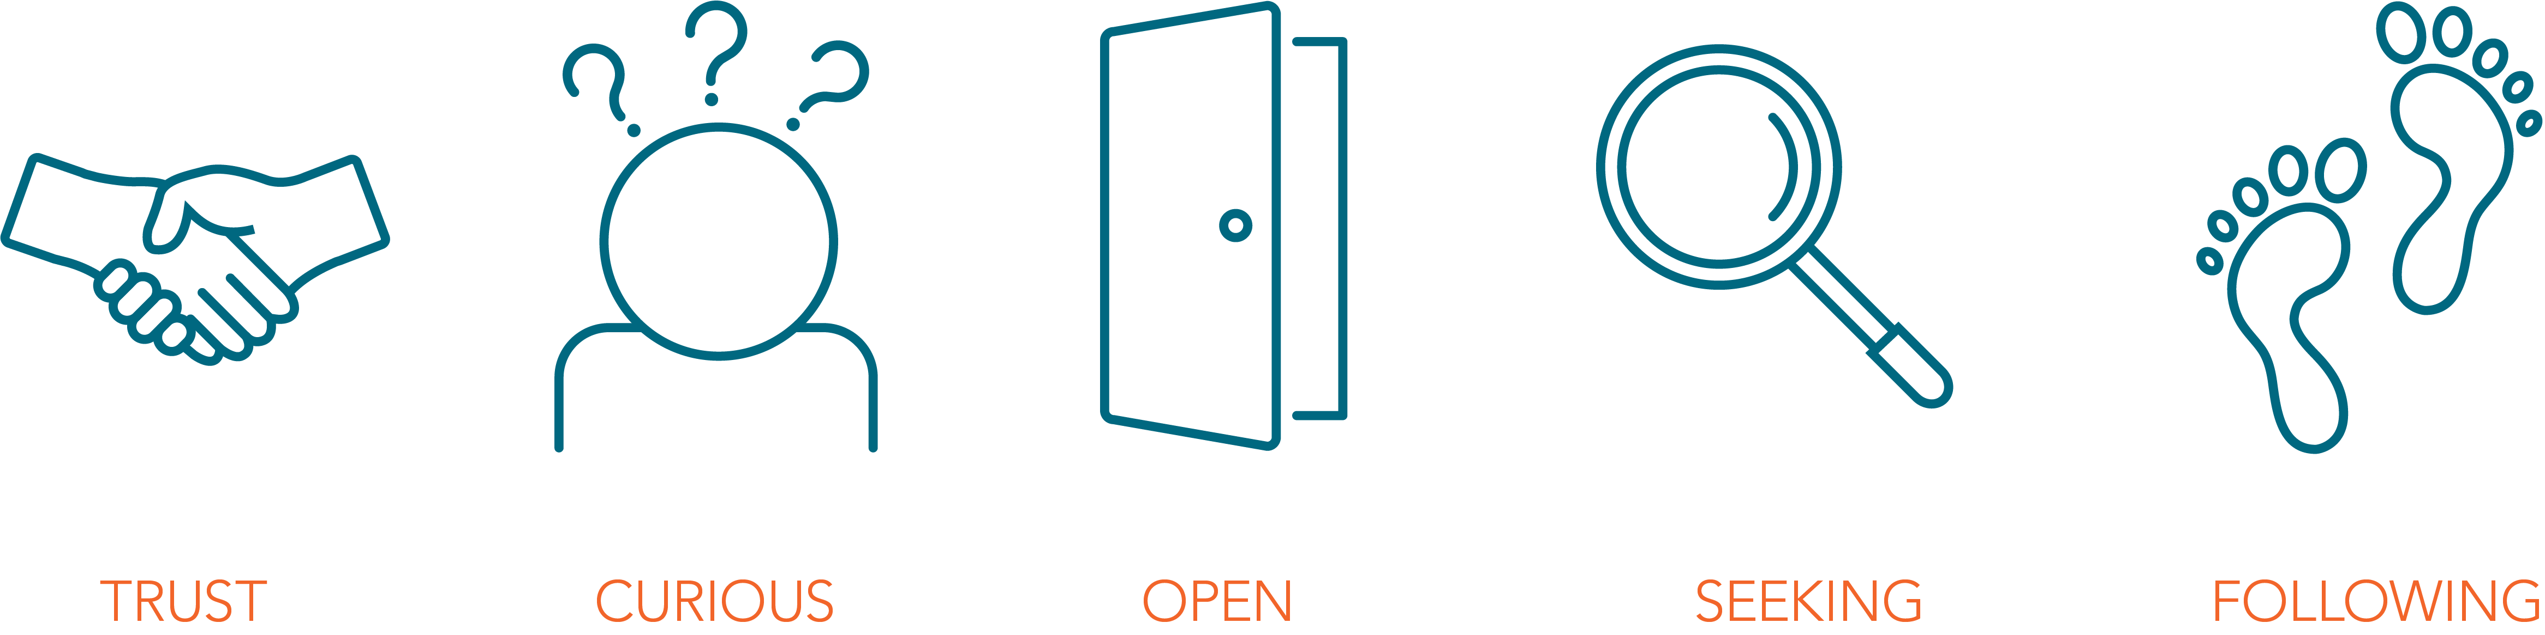

THE FIVE THRESHOLDS
From I Once Was Lost by Doug Schaupp and Don Everts (IVP)
Notes:
These are InterVarsity’s 5 Thresholds, or 5 steps that non-Christians commonly go through on their journey toward faith. We discovered these after interviewing a multi-ethnic, diverse group of women and men during the ‘90s.They’re recorded in the IVP book I Once Was Lost if you would like to check it out and go deeper. Let’s jump into this awesome adventure together.

Slide 3

MARK 4:26-29
The harvest is more ripe
than we think.
Notes:
Jesus tells us that the harvest is good, the harvest is amazing, and he invites us to see the current harvest the way he sees it. Let’s read this fantastic parable and let Jesus shape how we think about the harvest.

Slide 4
²⁶ He [Jesus] also said, “This is what the kingdom of God is like.
A man scatters seed on the ground. Night and day
whether he sleeps or gets up, the seed sprouts and grows,
though he does not know how. ²⁸ All by itself the soil
produces grain—first the stalk, then the head, then the
full kernel in the head. ²⁹ As soon as the grain is ripe, he
puts the sickle to it, because the harvest has come.”
Mark 4:26-29 (NIV)
What is the farmer good at?
Notes:
(Read the Scripture, then click.) What is the farmer good at? (Discuss in pairs for 1 minute. Invite them back into the larger group setting. You can ask for 3-4 volunteers to shout 1 thing they see the farmer do well.)

Slide 5
What is the farmer good at?
Throwing the Seed
Watching and Waiting
Discerning the Growth
Harvesting the Crop
Notes:
Let’s talk about this. We see four key things. (Comment on each one as you click through the four.) Throwing the seed: He has a strong right arm and can throw the seed far!
Watching and waiting: He understands the mystery of growth and he stays engaged with the process. Discerning the growth: He does not get confused between a small stalk and the full head of grain. He does not try to harvest a tiny seedling. Harvesting the crop: He is very good with the sickle when it is time. He is skilled and urgent.

Slide 6
What are YOU good at?
Throwing the Seed:
you are good at
meeting people
Watching and Waiting:
you pray for the
harvest
Discerning the Growth:
you sense where people
are at with God
Harvesting the Crop:
you help people
commit to Jesus
Notes:
What are you good at? Let’s do a quick self-assessment. Pick the ONE area you are best at. Some of you are best at throwing the seed. That means you like meeting new people and you are friendly. Others of you are strong at intercession. You watch and wait; you pray for the harvest, and you embrace the mystery. Others of you discern the growth. Within about 5 minutes of meeting a non-Christian, you can guess their level of interest in God. Lastly, some of you are strong at the harvest and the sickle. You help people commit to Jesus.
(Turn in pairs for 30 seconds) Pick your strength. Now, let’s each vote. Raise your hand for the one you are best at. (Have them vote.) Which of you are best at meeting people? Which of you are best at intercession? Which of you are best at discernment? Which of you are best at helping people commit to Jesus? (Comment on the number of hands that go up. Affirm where they are strongest and point out where they have fewest votes. Make an observation, but do not be judgy.)

Slide 7
The Harvest Paradox
  Is it a patient process
  or an urgent moment?
  Is it a mystery or a predictable pattern?
  Who is the active
  agent in the harvest?
  The ground, the seed,
  or the farmer?
A paradox is “a situation that combines contradictory qualities.”
Notes:
The harvest is a paradox. Is it a patient process or an urgent moment? Yes! Is it a mystery or a predictable pattern? Yes! Who is the active agent in the harvest: the ground, the seed, or the farmer? YES!
Jesus just wrecked all of our theologies. Entire books have been written on one side of this paradox or the other. Jesus invites us into the tension of the harvest.

Slide 8
THE FIVE THRESHOLDS
Notes:
In InterVarsity, we embrace the different parts of the harvest and we equip our members to thrive in the harvest using The 5 Thresholds of Faith. Let’s dig into each threshold and identify the key barrier to overcome.

Slide 9



Distrust
Trust
Distrust
Notes:
In the 1st Threshold, we sometimes encounter Distrust in today’s age of skepticism. Particularly on the coasts, Distrust is often the knee-jerk reaction we get when others find out that we are Christians.
So, we become trust-builders. Instead of being offended by Distrust, we engage in intentional trust-building by sharing our hobbies. We invite them to do what we like to do, and we join them in doing what they like to do. This is called trust-building.

Slide 10

Why don’t people
automatically trust Christians today?
What hobbies can you share with others?
Notes:
Why don’t people automatically trust Christians today? In the past, Christians were highly trusted. Because of some of the scandals in the church, people unfortunately trust us less today. What hobbies can you share with others? (Optional: 1 minute in pairs to discuss.)

Slide 11



Indifferent
Indifferent
Curious
Notes:
Then in the 2nd Threshold, they are Indifferent. They may trust us, they may like us, but they may not care at all about our faith. There is a myth that if we are a nice Christian, they will eagerly ask us questions about our faith. This is very seldom true today.
Here’s the funny thing about our postmodern context. Let’s pretend that I am a typical postmodern person, with 4 friends. I have an atheist friend, I have a lesbian friend, I have a Marxist friend, I have a Christian friend. Each of my 4 friends are wonderful and crazy, and what each one believes has no impact whatsoever on what I believe. Therefore, I feel no contradiction about the fact that I can like them all as my friends, and yet feel totally indifferent to their respective beliefs.
Instead of being offended by their Indifference, we help them become Curious. And then they ask us “Do dogs go to heaven?” How do we help them become Curious? We ask them questions about themselves.

Slide 12

Jesus is superb at asking great questions.
Why are his followers so focused on the right answers?
What are a few questions you can ask?
Notes:
Jesus is superb at asking great questions. Jesus did not have Q&A sessions. Jesus had Q&Q sessions, as our friend Tom Hughes points out. If you asked Jesus a question, he’d often ask you a question right back. So why are his followers so focused on the right answers when our Lord Jesus is so good at asking questions and making people Curious? What are a few questions you could ask? Here are two of my favorites: (1) What is your spiritual background? (2) What does that mean for you today? (Break into pairs.) What are your 2 favorite questions?

Slide 13



Closed to Change
Closed to
Change
Open to
Change
Notes:
In the 3rd Threshold, they like to ask us abstract questions, they’re willing to talk about some spiritual topics, but their heart is Closed to Change, like this safe here.
By the end of the 3rd Threshold, they are actually Open. They open their hearts, they open their personal lives to us. What is the best way that we can help them move from Closed to Change to Open to Change? By being vulnerable ourselves. Let's open our hearts to them and reveal the real struggles in our personal lives. Let’s tell them how God is engaging with us in real ways. As we are transparent, we help them reciprocate and open their hearts toward us. Your authenticity and transparency is often the door toward Jesus that they walk through.

Slide 14

Many people see themselves as open minded…
until you ask them to try praying with you.
How can you be more vulnerable in your relationships?
Notes:
Many people see themselves as open-minded, until you ask them to try praying with you. Please try this. This is a great way to help move people through the 3rd Threshold. Also, what is one way that you can be vulnerable this week with one non-Christian friend? (Optional: discuss in pairs.)

Slide 15



Wandering
Wandering
Seeking
Notes:
In the 4th Threshold, they are Wandering. They are exploring Buddha, Krishna, crystals, and Jesus. This drives us nuts. “Why are they wasting their time looking at four things at the same time?!” The reason they are stuck in the maze is because no one has ever taught them to seek.
The end of the 4th Threshold is beautiful, when they actually become Seekers of Jesus. What is the most helpful way to move them from Wandering to Seeking? By clarifying their quest. We have the honor of coming alongside our friends, and helping them get clear about what they need to know about Jesus.

Slide 16

Many seekers seldom take steps forward
because they are wandering.
What is the most important question you have for Jesus, to figure out if he is trustworthy with your life?
Notes:
Many seekers seldom take steps forward because they are wandering. We get to ask them a really helpful question, like this: “What is the most important question you have for Jesus to figure out if he is trustworthy with your life?” Please memorize this question. (Practice in pairs.)

Slide 17

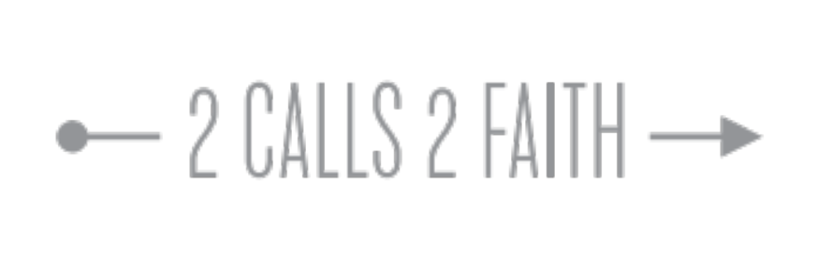

Ambivalent
Ambivalent
Follower
of Jesus
Notes:
In the 5th Threshold, sometimes people get stuck with Ambivalence. This means they are paralyzed at the point of decision-making about Jesus. They’re not sure what to do. We get to help them consider following Jesus with the rest of their lives. This is wonderful. That’s where the 5th Threshold ends.
What is the best way to help them become a follower of Jesus. One way we like to do this is to tell them “Everybody has a crucial decision to make. Who will be at the center of your life? Do you want you, yourself, to be at the center of your life? Or do you want to let Jesus become the center of your life? I think you and I would be wise to make Jesus the center of our lives. What would it take for you to follow Jesus, and allow Jesus to become the center of your life?”

Slide 18

Jesus loves to invite
people to become his followers.
We get to offer the same invitation!
How can you grow as an inviter?
Notes:
Jesus loves to invite people to become his followers. We get to offer the same invitation! How can you grow as an inviter? (Optional: pairs to discuss for 1 minute.)

Slide 19

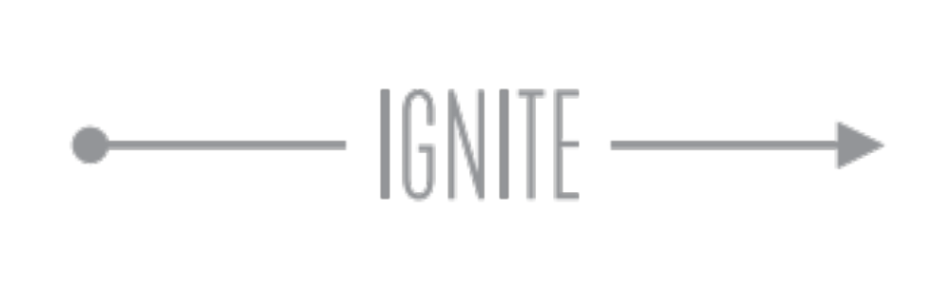

Timid
Timid
Faithful
Witness
Notes:
After you help them become a follower of Jesus, they often are Timid about being a witness.
This is our icon for Faithful Witness. A Faithful Witness has the cross at the center of their life, and they actually help a friend who is Curious or Seeking. That’s what the question mark represents. What is the best way to help a Timid new believer become a Faithful Witness? We call it Ignite. Ignite is sharing our hobbies and passions, having honest conversation, and then inviting our friends to explore Jesus with us. I’d be happy to tell you more about this later.

Slide 20
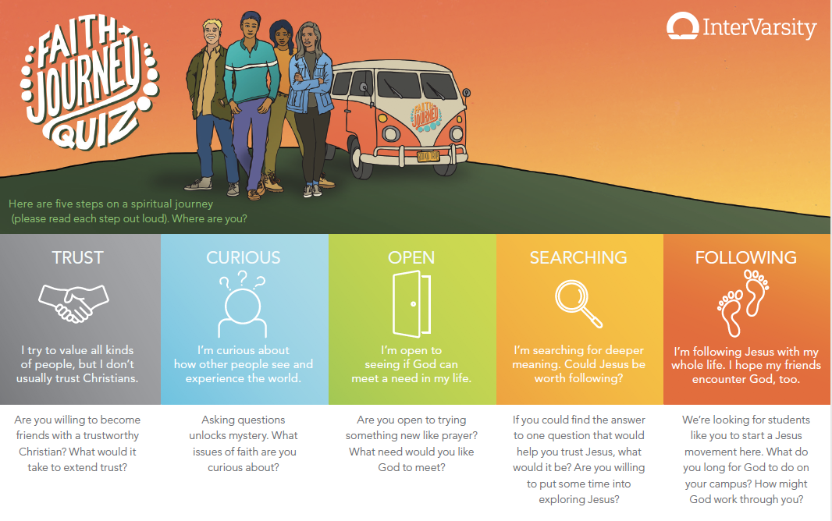
Let’s Go!
Pray for 2 of your friends
STRETCH GOAL
Share the 5 Thresholds quiz with a friend
store.intervarsity.org/evangelism
Notes:
We all get to join Jesus in his fruitful harvest! Let’s do this in two ways. First, let’s pray, for the harvest. Our favorite prayer card is the 2+ prayer card. Each of us can lay a foundation of intercession by praying for 2 of your non-Christian friends. Who are the two non-Christian friends you would like to pray for? (Pray for two minutes in pairs.)
Second, we can have good conversations with non-Christians, using the 5 Threshold Quiz. It is written as a self-diagnostic. You can buy it online or download at https://intervarsity.org/adopt-a-campus/meet-new-people-and-start-spiritual-conversations. Ask me afterward how to use it. https://intervarsity.org/sites/default/files/resources/Faith-Journey-Quiz-Script.pdf
In closing, the harvest is more ripe than we think. We have the great joy of partnering with Jesus in helping our friends move through the 5 Thresholds. This is the greatest adventure of our lifetimes!

