Slide 1


Bucket List Proxe

Slide 2

Panel 1
Ask students to place a sticker on one of these things that’s at the top of their bucket list.

Slide 3

Panel 1
Athletes Version
Ask students to place a sticker on one of these things that’s at the top of their bucket list.

Slide 4

Panel 2
This panel focuses on priorities. If we knew our days were numbered, how would our priorities be different? They indicate this on a post-it note. This transitions very well to the story of Moses in Exodus 33, 34 on the 3rd panel.

Slide 5
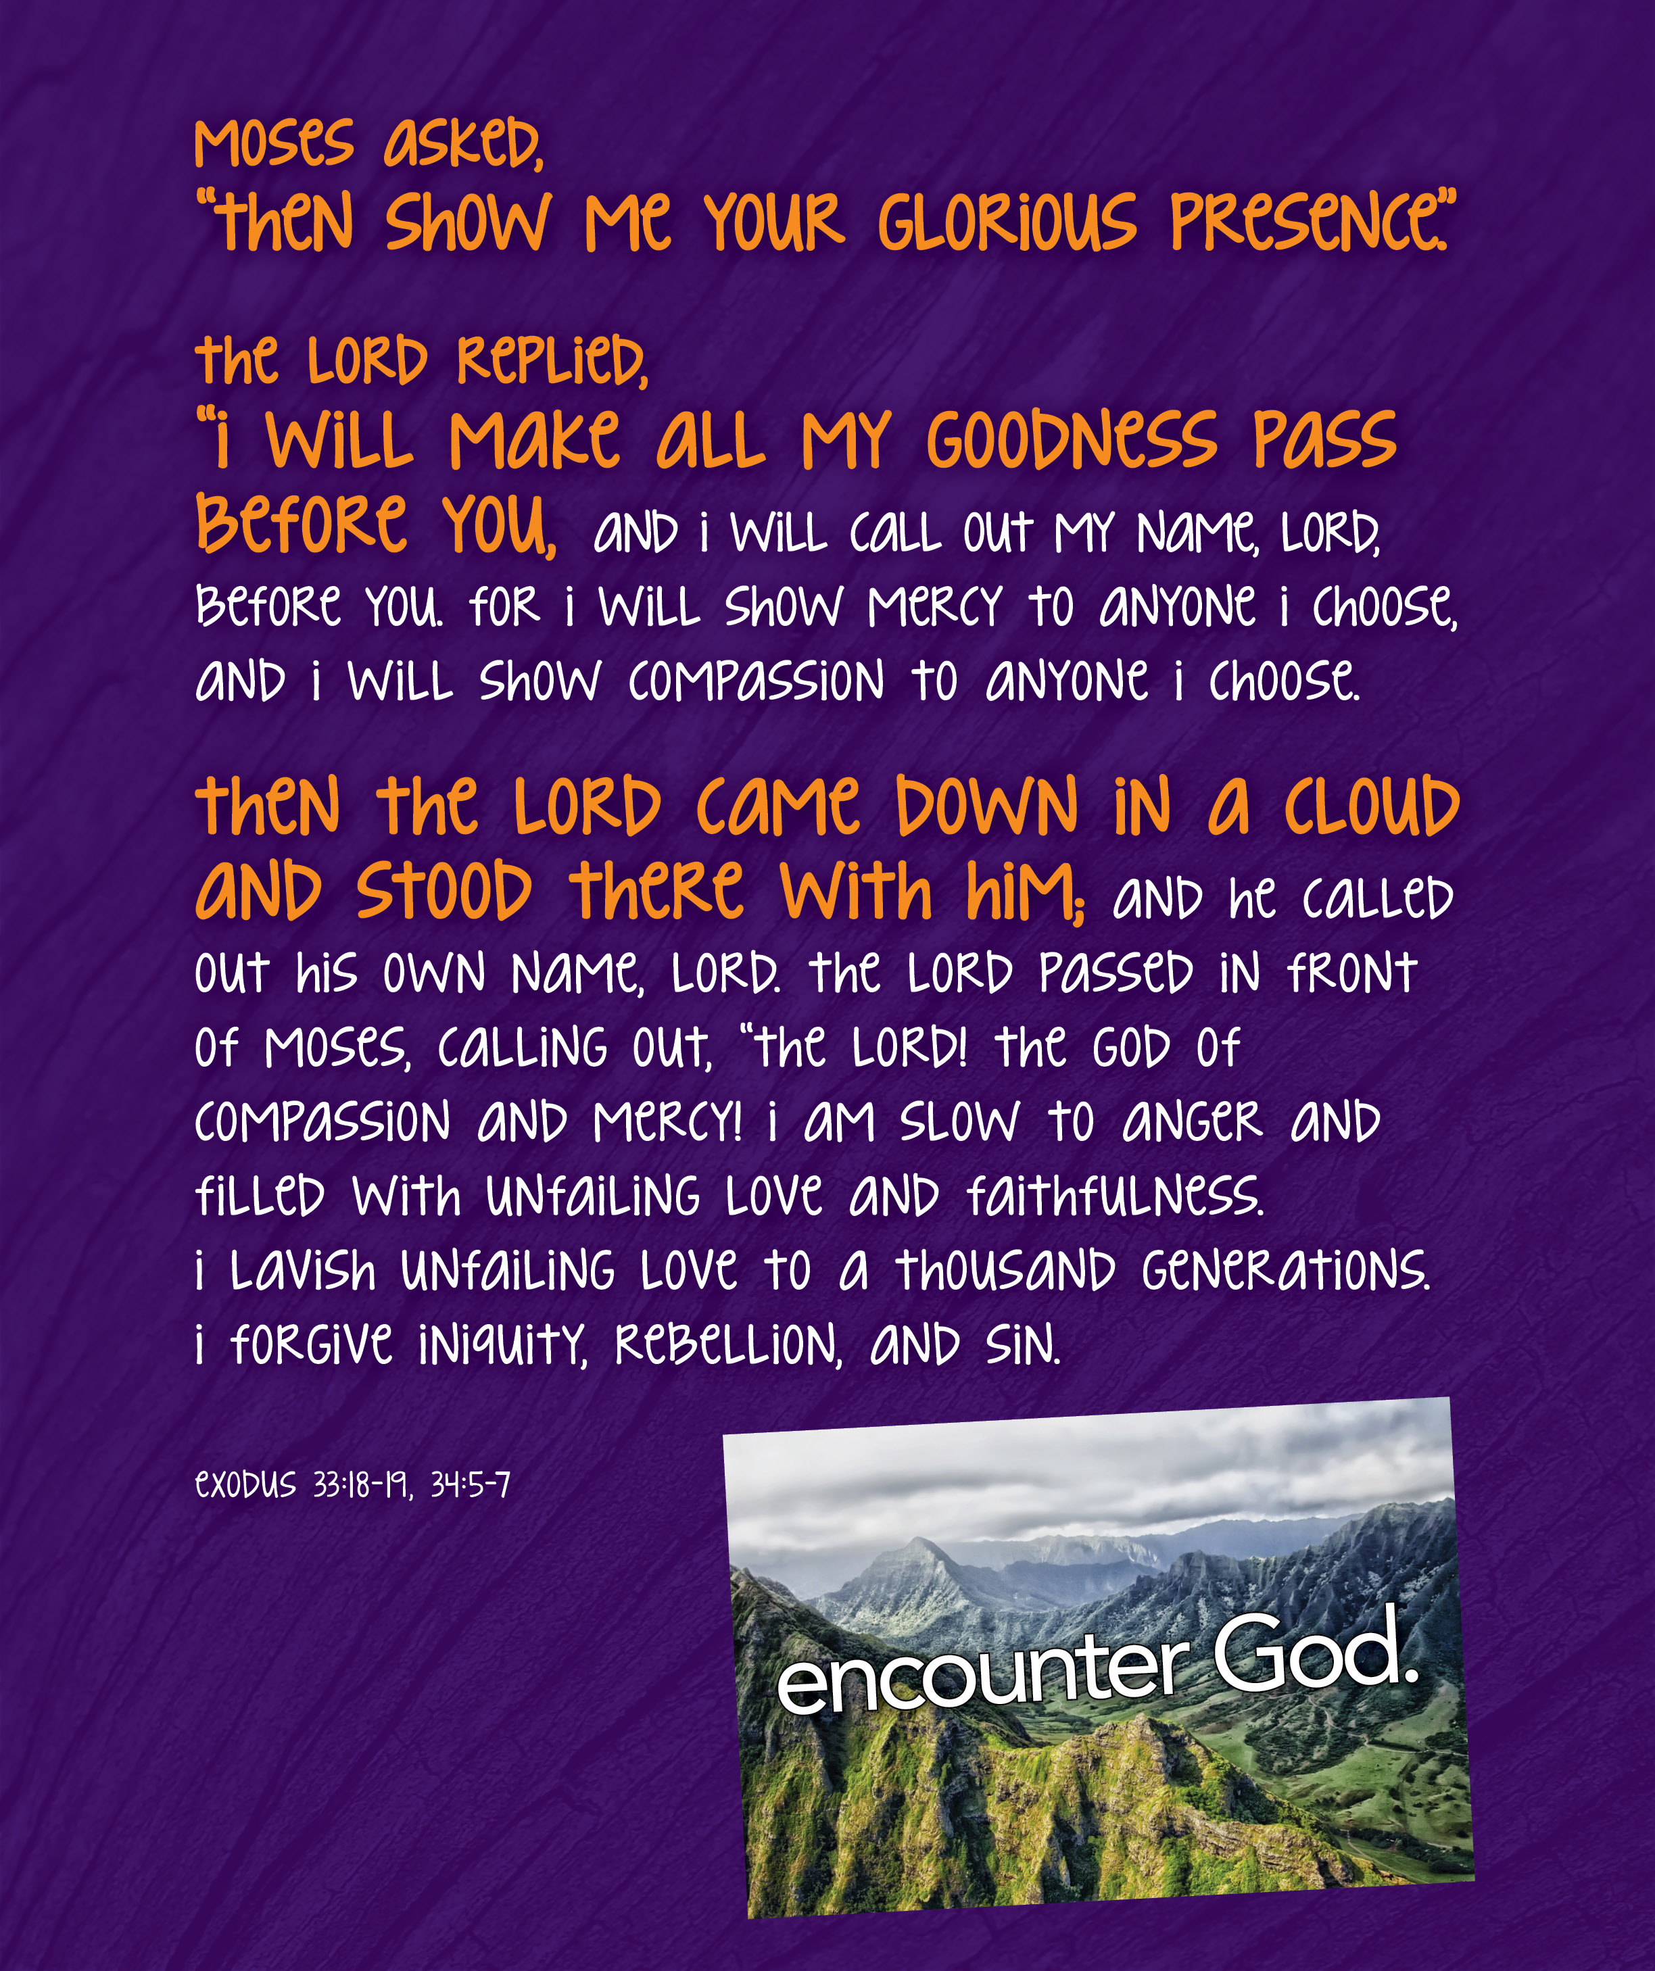
Panel 3
There was a guy in the Bible who also had a Bucket List and he prioritized encountering God. Can we pray right now that you would encounter God?

Slide 6
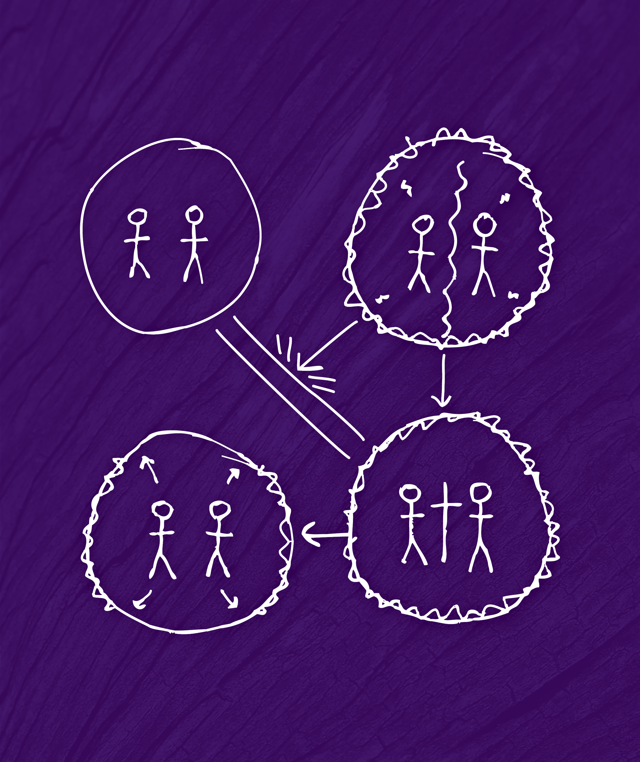
Panel 4
God has chosen to reveal himself to us personally and to the whole world through the story of Jesus. Present the Big Story Gospel outline and invite them to know God and make his name known.

